Slide 1
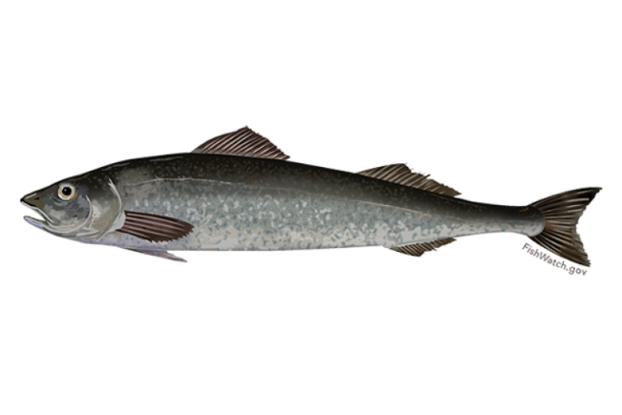

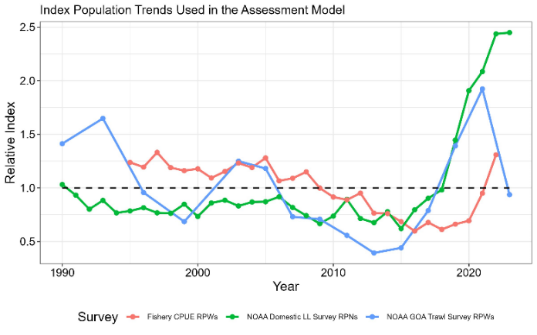
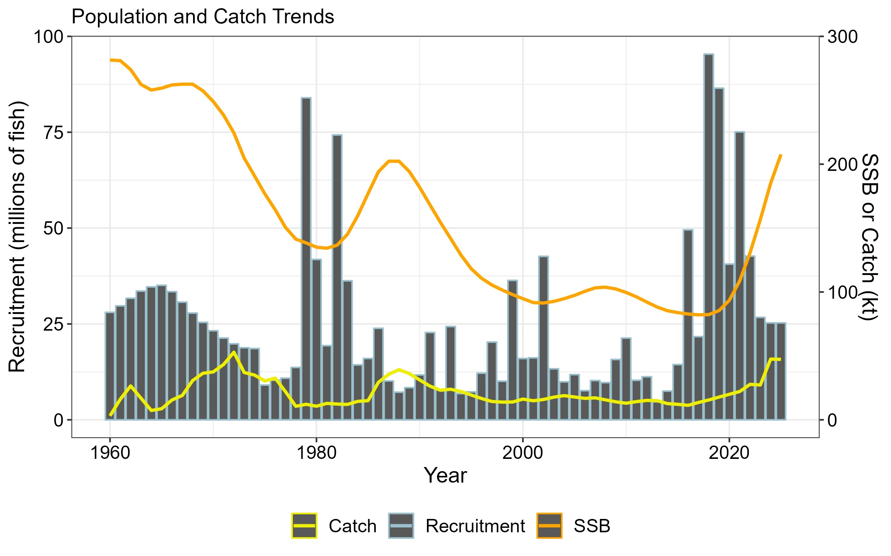
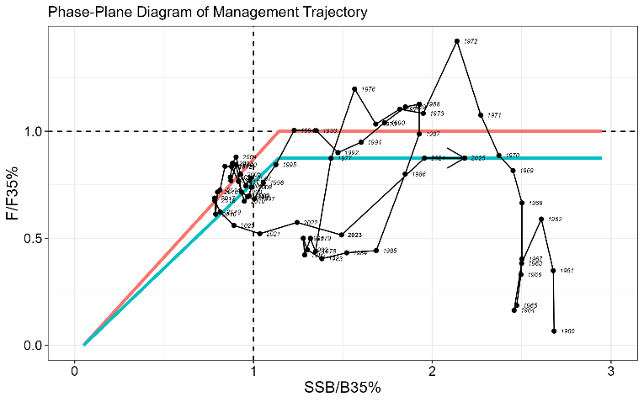
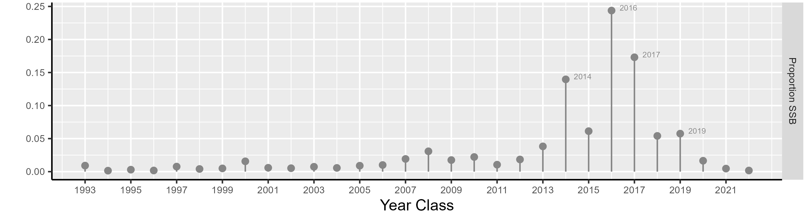
2023 Alaskan Sablefish SAFE (Anoplopoma fimbria)
Data and Stock Assessment Model
Following steady increases in abundance and biomass indices since 2015, the 2023 NOAA longline survey abundance was stable matching the 2022 value, the NOAA Gulf of Alaska trawl survey declined precipitously, and the fixed gear fishery CPUE continued to increase.
The author proposed model (23.5) integrated minor data refinements and parametrization updates, but the main structure was consistent with the previously accepted model (21.12).
The biomass and SSB continue to increase, while recruitment has been at or above the mean since 2014.
Stock Status and ABC Recommendations
Quantity | 2022 SAFE (Projections for 2023) | 2023 SAFE (Projections for 2024)
B_{100%} | 305,595 | 299,901
B_{40%} | 122,238 | 119,960
SSB_{(Terminal_Yr+1)} | 159,788 | 185,079
SSB_{(Terminal_Yr+1)}/B_{100%} | 52% | 62%
F_{ABC(Terminal_Yr+1)} | 0.081 | 0.086
ABC_{w(Terminal_Yr+1)} | 40,502 | 47,146
OFL_{w(Terminal_Yr+1)} | 47,390 | 55,084
*SSB projections are based on specified catch for the terminal year. ABC_{w} and OFL_{w} are the recommended values after whale depredation has been taken into account.
The resource is not overfished and overfishing is not occurring.
Recent ABCs have not been fully utilized with catch averaging ~70% of the ABC over the last 3 years.
The ABC increased by 16% due to continued maturation and growth (in weight) of the population.
Other Considerations
The population age-structure remains contracted relative to historic levels.
2014 – 2020 year classes comprise > 75% of projected 2024 SSB.

